Slide 1




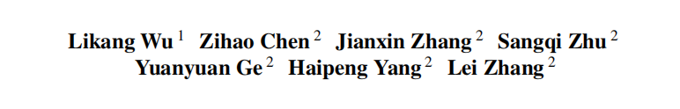






ATAI
Advanced Technique of Artificial Intelligence
ATAI
ChongqingUniversity _{AdvancedTechniqueof}
of Technology Artificial Intelligence
Chongqing University of
Technology
Chongqing University ^{ATAI}
_{of Technology} Advanced Techniqueof
Artificial Intelligence
Chongqing University of Technology
Chongqing University of Technology
GCIB: Graph Contrastive Information Bottleneck
for Multi-Behavior Recommendation
code: https://github.com/akajinchen/GCIB
——ICML_2026
Reported by Yuhe Liu
1

Slide 2
ATAI
Advanced Technique of Artificial Intelligence
ATAI
ChongqingUniversity _{AdvancedTechniqueof}
of Technology Artificial Intelligence
Chongqing University of
Technology
Chongqing University ^{ATAI}
_{of Technology} Advanced Techniqueof
Artificial Intelligence
Chongqing University of Technology
Chongqing University of Technology
Motivation
Because target-behavior data are sparse, researchers use auxiliary behaviors such as clicks and add-to-cart actions to provide additional information.
However, these behaviors can also contain noise, and directly integrating them may hinder the learning of users’ target preferences. This motivates the authors to investigate how to identify auxiliary information that is truly useful for the target recommendation task.
Notes:
同质图：节点都是一种类型，例如“用户”。边也是一种类型， “交互”。U-I图其实就是异构图

Slide 3
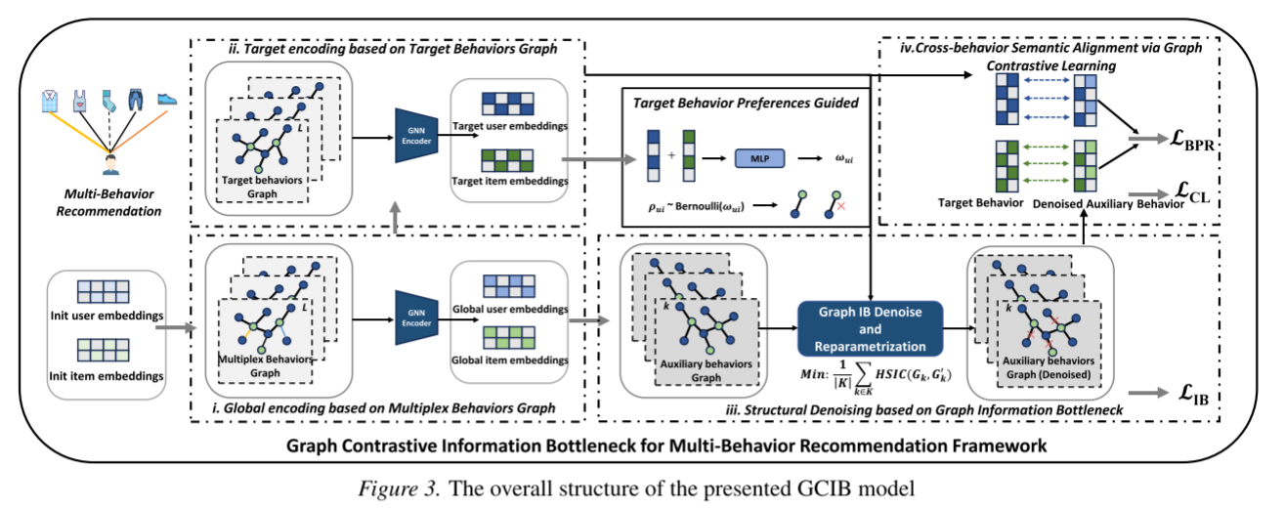
ATAI
Advanced Technique of Artificial Intelligence
ATAI
ChongqingUniversity _{AdvancedTechniqueof}
of Technology Artificial Intelligence
Chongqing University of
Technology
Chongqing University ^{ATAI}
_{of Technology} Advanced Techniqueof
Artificial Intelligence
Chongqing University of Technology
Chongqing University of Technology
Method
Notes:
同质图：节点都是一种类型，例如“用户”。边也是一种类型， “交互”。U-I图其实就是异构图

Slide 4





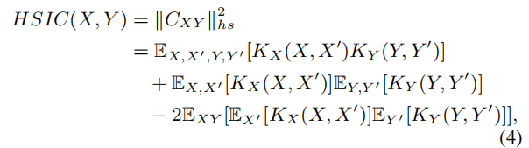


ATAI
Advanced Technique of Artificial Intelligence
ATAI
ChongqingUniversity _{AdvancedTechniqueof}
of Technology Artificial Intelligence
Chongqing University of
Technology
Chongqing University ^{ATAI}
_{of Technology} Advanced Techniqueof
Artificial Intelligence
Chongqing University of Technology
Chongqing University of Technology
Method

Slide 5

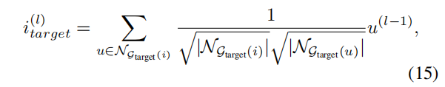

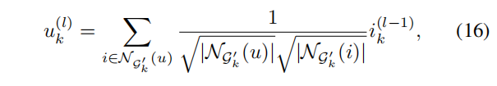


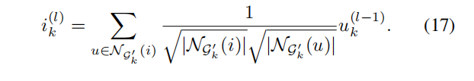
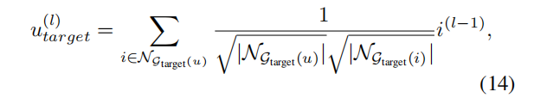

ATAI
Advanced Technique of Artificial Intelligence
ATAI
ChongqingUniversity _{AdvancedTechniqueof}
of Technology Artificial Intelligence
Chongqing University of
Technology
Chongqing University ^{ATAI}
_{of Technology} Advanced Techniqueof
Artificial Intelligence
Chongqing University of Technology
Chongqing University of Technology
Method
Notes:
同质图：节点都是一种类型，例如“用户”。边也是一种类型， “交互”。U-I图其实就是异构图

Slide 6

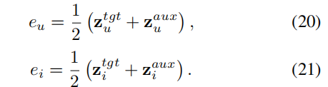


ATAI
Advanced Technique of Artificial Intelligence
ATAI
ChongqingUniversity _{AdvancedTechniqueof}
of Technology Artificial Intelligence
Chongqing University of
Technology
Chongqing University ^{ATAI}
_{of Technology} Advanced Techniqueof
Artificial Intelligence
Chongqing University of Technology
Chongqing University of Technology
Method
Notes:
同质图：节点都是一种类型，例如“用户”。边也是一种类型， “交互”。U-I图其实就是异构图

Slide 7

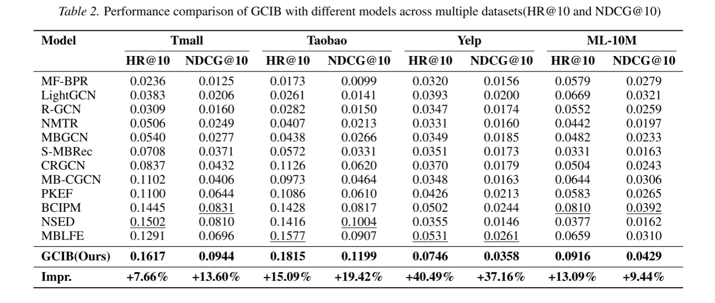
ATAI
Advanced Technique of Artificial Intelligence
ATAI
ChongqingUniversity _{AdvancedTechniqueof}
of Technology Artificial Intelligence
Chongqing University of
Technology
Chongqing University ^{ATAI}
_{of Technology} Advanced Techniqueof
Artificial Intelligence
Chongqing University of Technology
Chongqing University of Technology

Slide 8
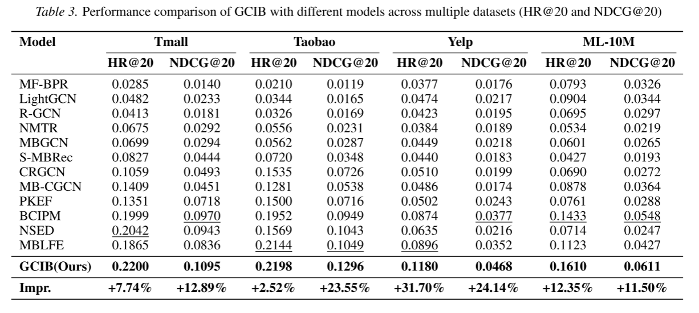
ATAI
Advanced Technique of Artificial Intelligence
ATAI
ChongqingUniversity _{AdvancedTechniqueof}
of Technology Artificial Intelligence
Chongqing University of
Technology
Chongqing University ^{ATAI}
_{of Technology} Advanced Techniqueof
Artificial Intelligence
Chongqing University of Technology
Chongqing University of Technology

Slide 9
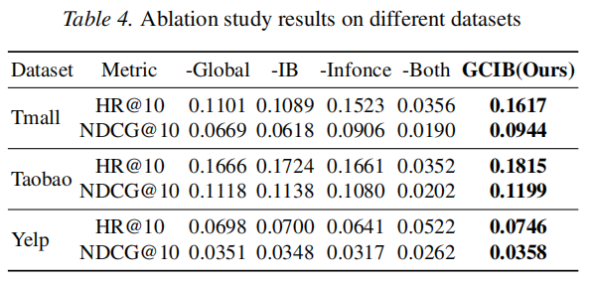
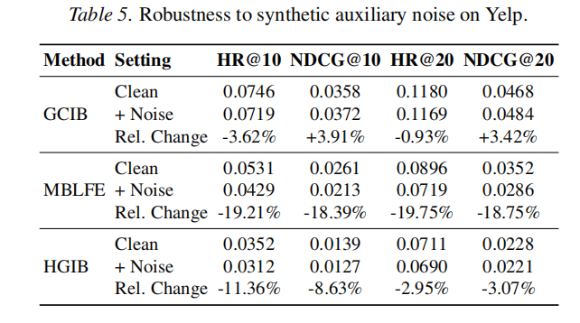
ATAI
Advanced Technique of Artificial Intelligence
ATAI
ChongqingUniversity _{AdvancedTechniqueof}
of Technology Artificial Intelligence
Chongqing University of
Technology
Chongqing University ^{ATAI}
_{of Technology} Advanced Techniqueof
Artificial Intelligence
Chongqing University of Technology
Chongqing University of Technology

Slide 10
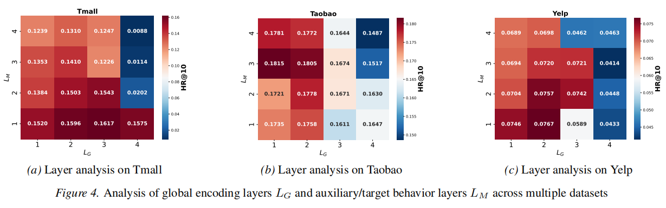
ATAI
Advanced Technique of Artificial Intelligence
ATAI
ChongqingUniversity _{AdvancedTechniqueof}
of Technology Artificial Intelligence
Chongqing University of
Technology
Chongqing University ^{ATAI}
_{of Technology} Advanced Techniqueof
Artificial Intelligence
Chongqing University of Technology
Chongqing University of Technology

Slide 11
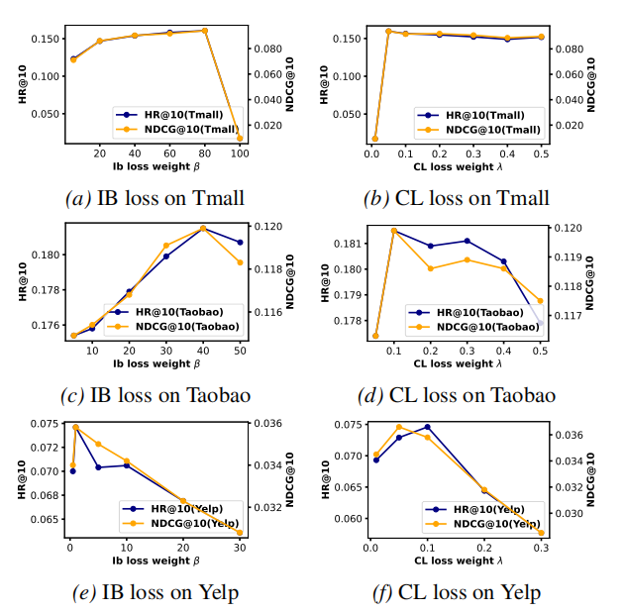
ATAI
Advanced Technique of Artificial Intelligence
ATAI
ChongqingUniversity _{AdvancedTechniqueof}
of Technology Artificial Intelligence
Chongqing University of
Technology
Chongqing University ^{ATAI}
_{of Technology} Advanced Techniqueof
Artificial Intelligence
Chongqing University of Technology
Chongqing University of Technology

Slide 12


ATAI
Advanced Technique of Artificial Intelligence
ATAI
ChongqingUniversity _{AdvancedTechniqueof}
of Technology Artificial Intelligence
Chongqing University of
Technology
Chongqing University ^{ATAI}
_{of Technology} Advanced Techniqueof
Artificial Intelligence
Chongqing University of Technology
Chongqing University of Technology
Thanks!

